Slide 1
Announcements
EC3 deadline has been extended by 1 week

Slide 2

Perceptrons
Read AIMA - Section 18.6.3
And Chapter 1
Of Nielsen’s “Neural Networks and Deep Learning”
Slides Courtesy of Dan Klein and Pieter Abbeel --- University of California, Berkeley
[These slides were created by Dan Klein and Pieter Abbeel for CS188 Intro to AI at UC Berkeley. All CS188 materials are available at http://ai.berkeley.edu.]

Slide 3
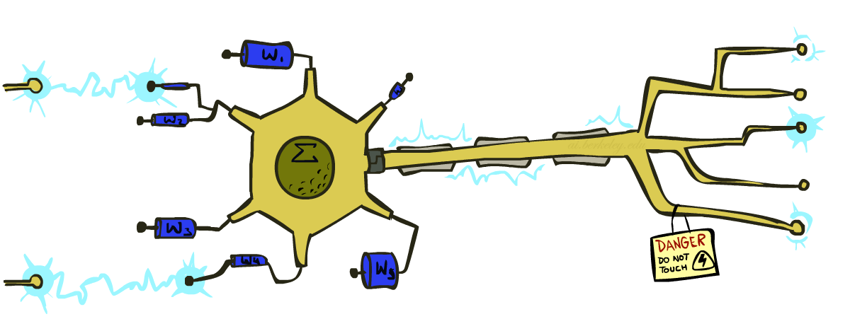
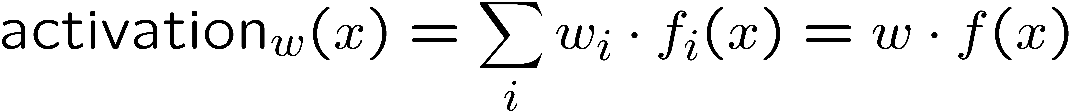
Recap: Linear Classifiers
Inputs are feature values
Each feature has a weight
Sum is the activation
If the activation is:
Positive, output +1
Negative, output -1
w₁
f₁
Σ
w₂
>0?
f₂
w₃
f₃
Notes:
The activation for some weight vector w given some input x is the Sum for each weight w_i in the weight vector with the corresponding entry in the feature vector representing x, f_i(x).
We also write this as w * f(x), which is the inner product of the weight vector and the feature vector.
Depending on whether the sum is positive, or the sum is negative, we output a positive class label or a negative class label (for the binary classification case).
This is the generic picture that represents the perceptron..
This is called the “dot product” or sometimes the “inner product”

Slide 4

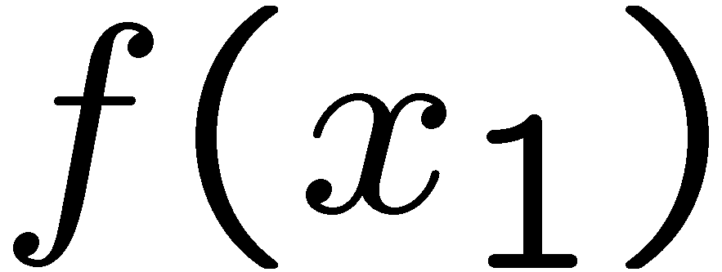
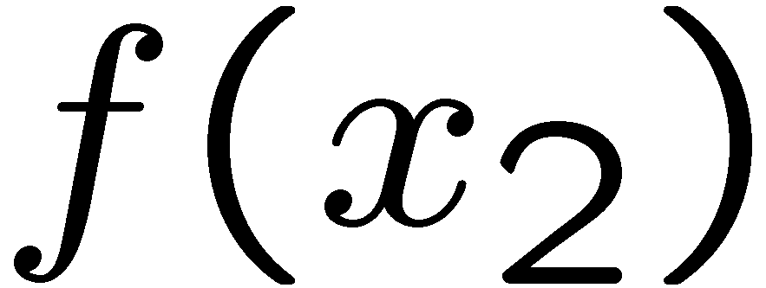
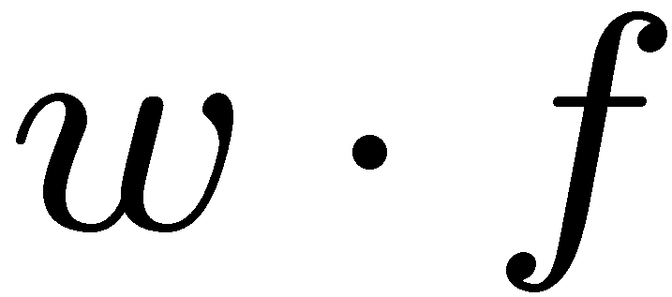
Recap: Weights
Binary case: compare features to a weight vector
Learning: figure out the weight vector from examples
# free : 4
YOUR_NAME :-1
MISSPELLED : 1
FROM_FRIEND :-3
...
# free : 2
YOUR_NAME : 0
MISSPELLED : 2
FROM_FRIEND : 0
...
# free : 0
YOUR_NAME : 1
MISSPELLED : 1
FROM_FRIEND : 1
...
Dot product positive means the positive class
Notes:
The feature values for inputs are fixed, but we can choose different weight vectors. Depending on the weight vector that we pick, we will get a different classifier.
Let’s look at an example, with the following weight vector. The first entry is a weight based on how often the word free appears. We get a high value for that. The next one is whether your name appears. This weight vector will lower the value. If there are misspelled words, the activation will go up. If the email comes from a friend then the activation will go up.
The weight vector always represents the positive class, so what is it in this case? It’s SPAM.
The weight vector lives in the same vector space as the feature vectors. Here’s are two feature vectors representing two emails that we want to classify.
For linear classification, we have a separating hyperplane. Separation is orthogonal to w. ((Draw this at a right angle to w)). Everything on the same side as w is the positive class Everything on the other side is the negative class.
For x2, the angle between w and f(x2) > 90 degrees, so it is negative.
If we compute the inner product then we’ll get a negative class when the angle is > 90 degrees like f(x_2).

Slide 5
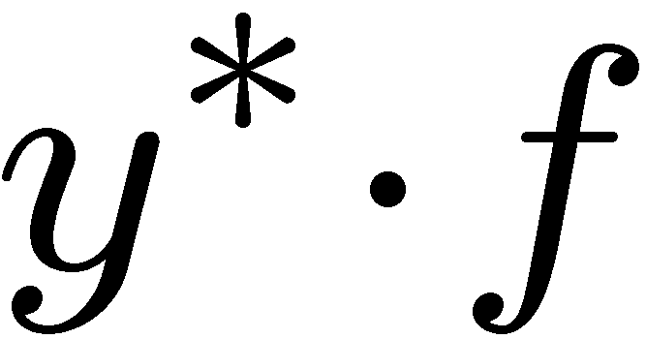
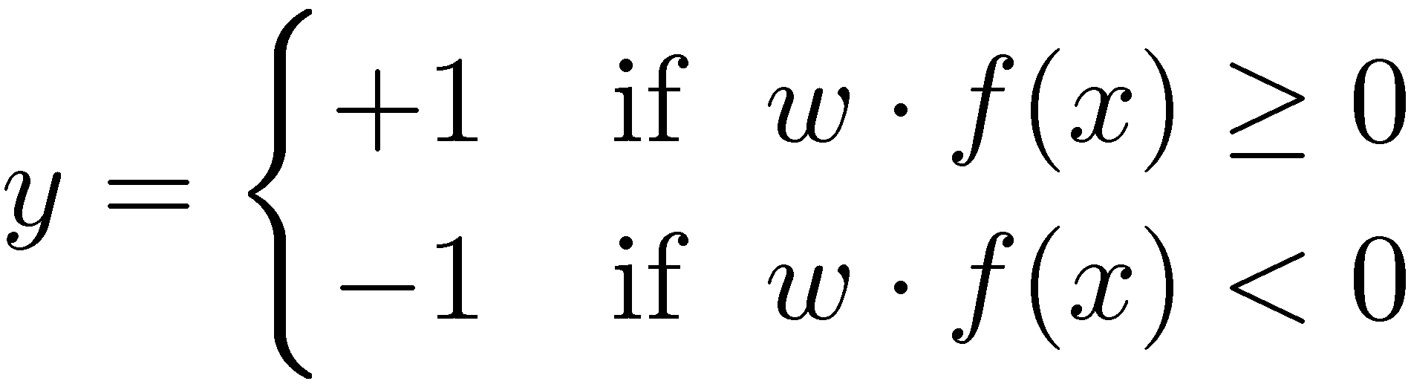

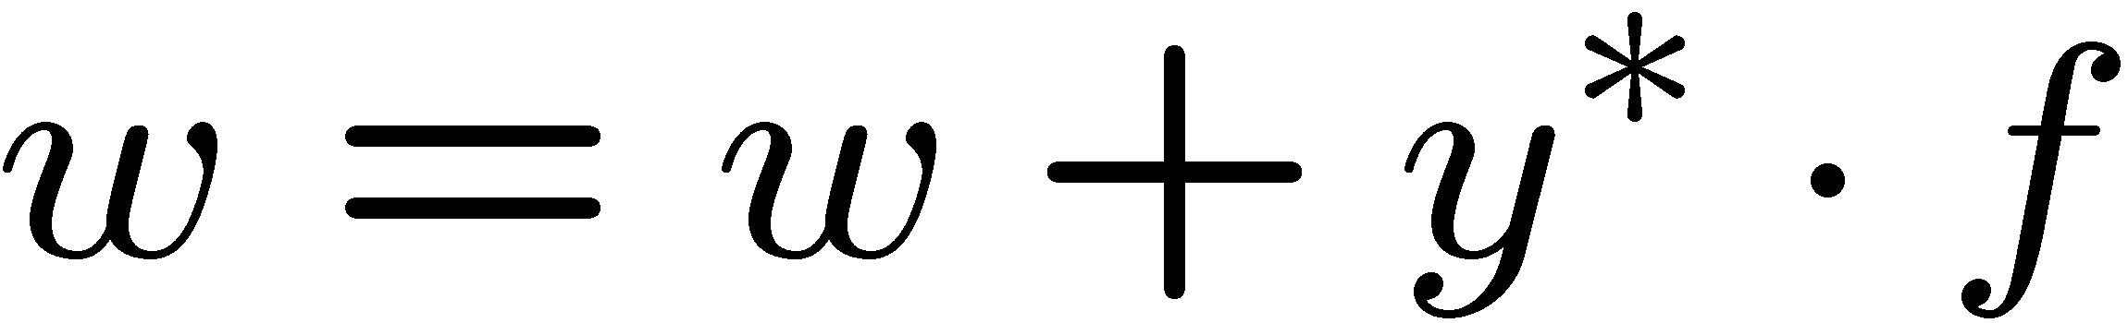
Recap: Learning a Binary Perceptron
Start with weights = 0
For each training instance:
Classify with current weights
If correct (i.e., y=y*), no change!
If wrong: adjust the weight vector by adding or subtracting the feature vector. Subtract if y* is -1.
Notes:
Mathematically what does it look like? You start with zero weights, and then for each thing you classify by running this computation here: w*f(x) and checking whether that inner product is positive or negative. You classify x as positive if the inner product is >= 0, and negative if it is <0.
You then check the correct label y* in the training example. The training example will tell you whether it should be positive or negative. If you’re correct, then no change.
If you’re wrong, then we will make an adjustment. For the picture here, f(x) get’s a positive classification. Let’s say that the training data tells us that it should be negative. Then we need to somehow adjust this. We need to rotate w and f apart, so that they hopefully now have a negative inner product.
F is fixed. W is the thing that we can change. We want to change is so that it is less aligned with f. If we want to make it less aligned with f, then we add the negative of f to w. ((draw it)). If we add the negative of F to W, then we get a new W ((draw it), and our decision boundary changes ((Draw it as at a right angle to the new W)).
The f is now of the other side of the decision boundary than it was before, which is our goal).
So here’s the update that we use if the update is wrong: we add y* (+1 or -1) * f to w

Slide 6
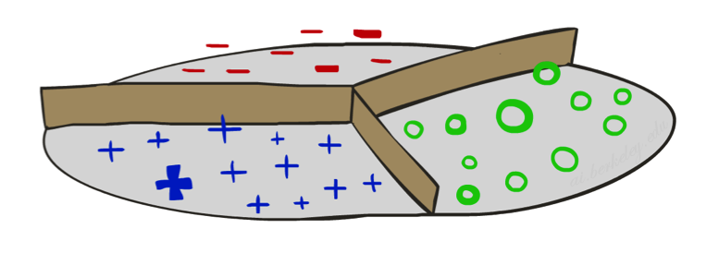
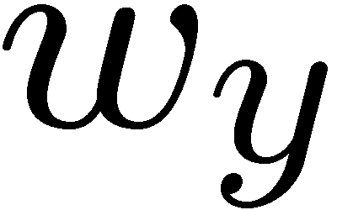
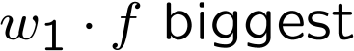
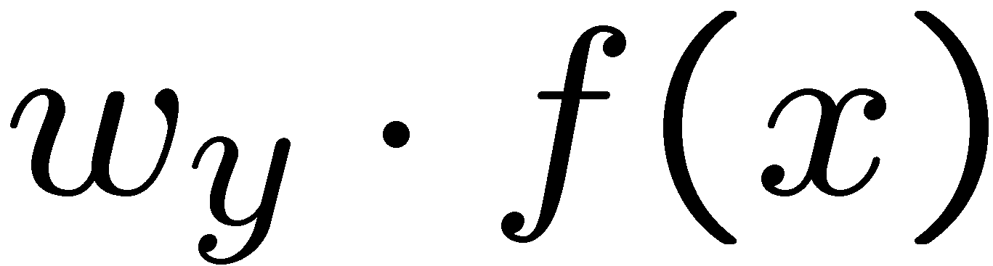

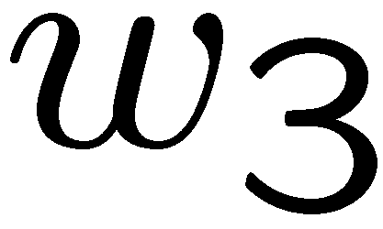
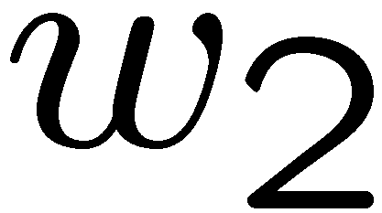
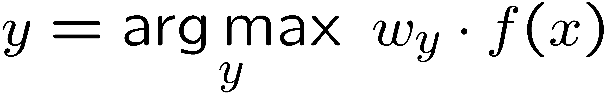
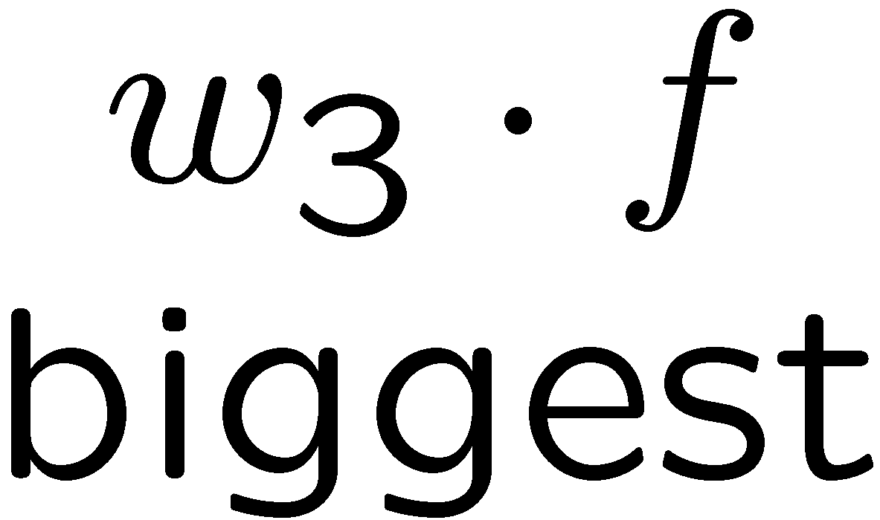
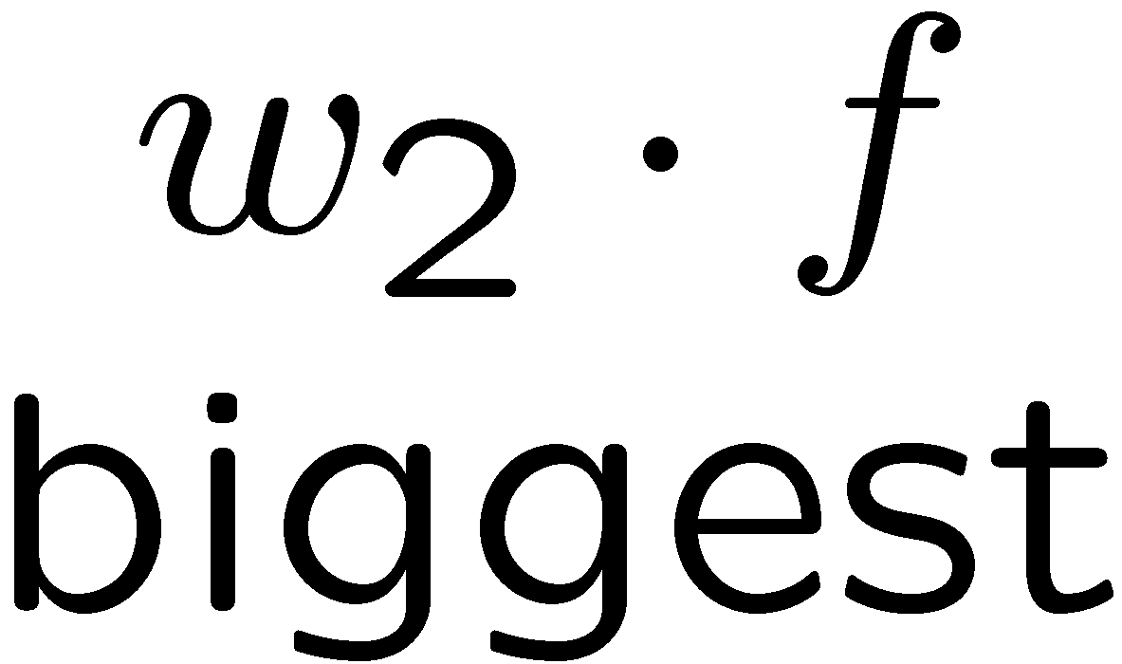
Multiclass Decision Rule
If we have multiple classes:
A weight vector for each class:
Score (activation) of a class y:
Prediction highest score wins
Binary = multiclass where the negative class has weight zero
Notes:
Here we’ll look at 3 classes on the slides, but this applies to any number of classes.
We have weight vector for each class.
If these are equal length, then the decision boundaries will be at the place that bisects the weight vectors (typically they won’t be equal length, which makes things a bit more complicated, but not much).
Now there is a w for each class (we index the classes by y). We compute w_y * f(x) for each class Y. Whichever one is the highest becomes our prediction for what class X should have.

Slide 7

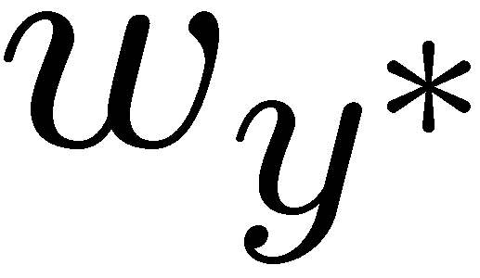
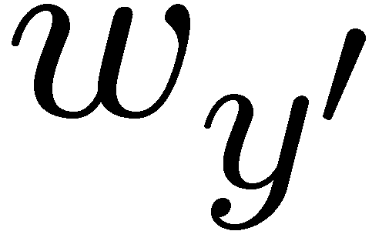
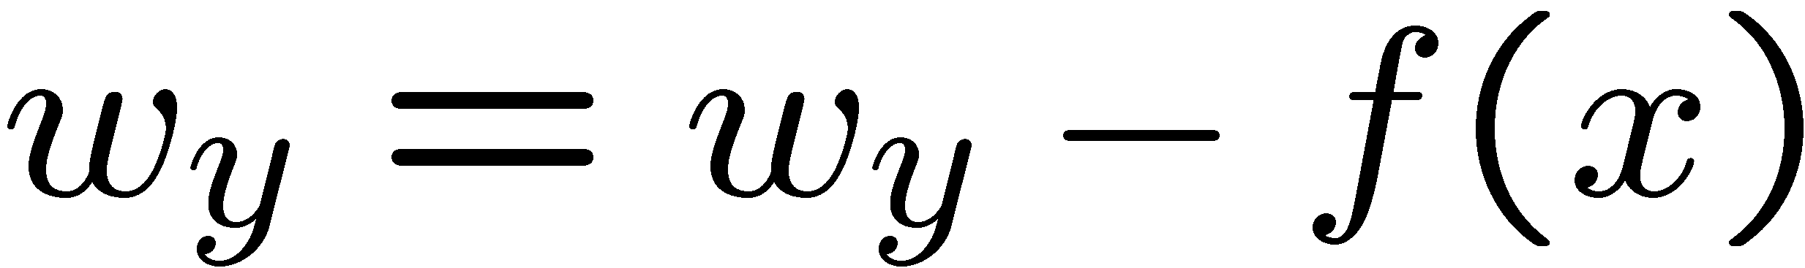
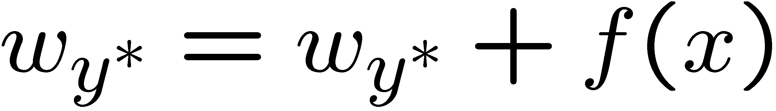
Learning: Multiclass Perceptron
Start with all weights = 0
Pick up training examples one by one
Predict with current weights
If correct, no change!
If wrong: lower score of wrong answer, raise score of right answer

Slide 8
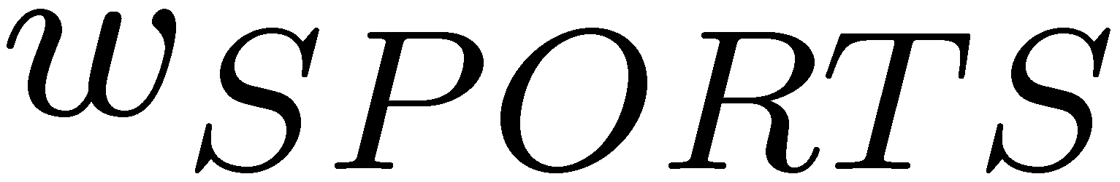
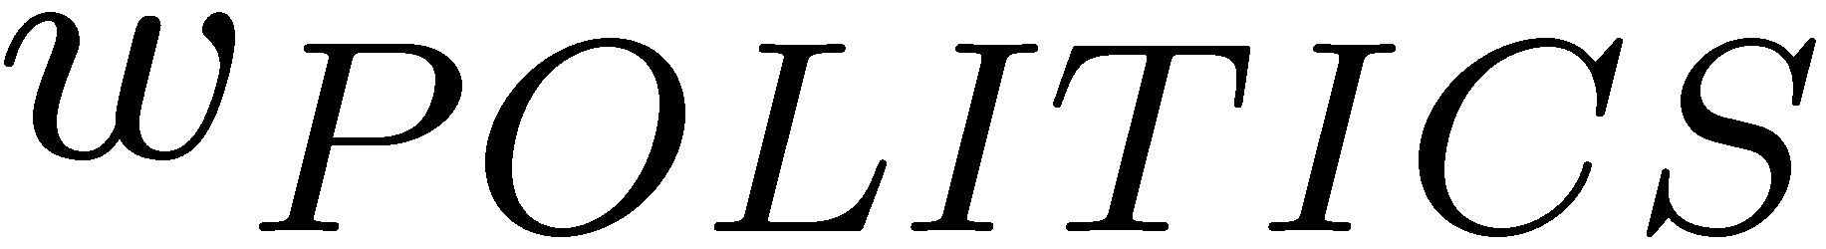
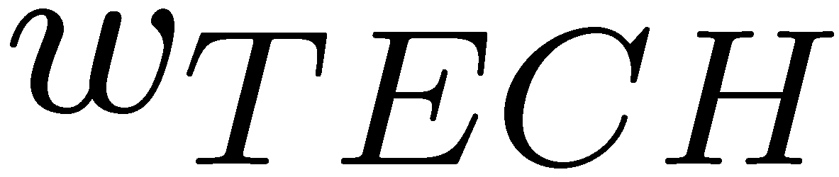
Example: Multiclass Perceptron
“win the vote”
“win the election”
“win the game”
BIAS : 1
win : 0
game : 0
vote : 0
the : 0
...
BIAS : 0
win : 0
game : 0
vote : 0
the : 0
...
BIAS : 0
win : 0
game : 0
vote : 0
the : 0
...
Notes:
Here are the initial weight vectors for each of our three classes. Now we have 3 inputs that we want to classify.
Let’s compute the values for each of the classes. It’s the inner product. Since sports has the bias term of 1, it wins. However, Let’s say that y* is poiitics.
We add f(x) to politics, which gives us a new w_politics of (1, 1, 0, 1, 1).
We subtract f(x) from sports, so we get a new w_sports of (0, -1, 0, -1, -1).
So that’s our first training example.
Let’s compute the score for “win the election”. The feature vector is 1, 1, 0, 0, 1.
For the inner products we get -2 for w_sports, 3 for w_politics and 0 for w_tech.
So the highest score is politics. That’s the correct label, so we don’t need to do any updates.
For win the game our f(x) is (1, 1, 1, 0, 1).
For the inner products we get -2 for w_sports, 3 for w_politics and 0 for w_tech.
Now we have to update by subtracting this f(x) from the politics weight vector, and add it to the sports weight vector.
Subtracting it out fom w_politics gives us new w_politics of (0, 0, -1, 1, 0).
We add f(x) tp sports, so we get a new w_sports of (1, 0, 1, -1, 0).
Then we go back to the first example. We keep looping until at some point, we run through all examples and nothing changes. If that’s the case then nothing will change in the future.

Slide 9
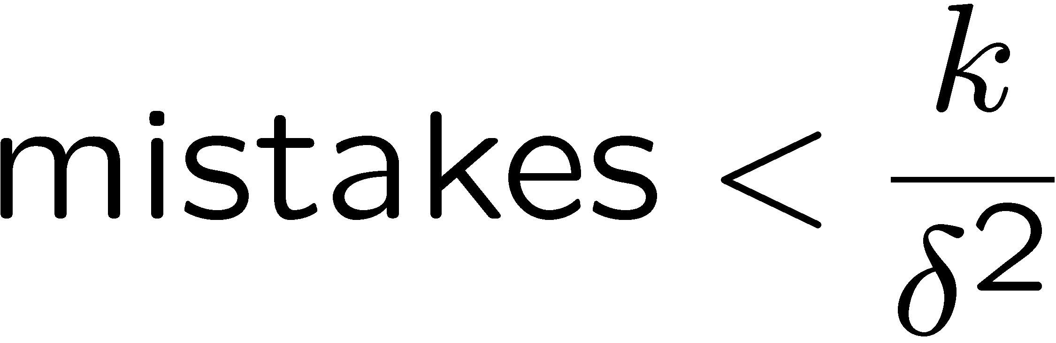
Properties of Perceptrons
Separable
Separability: true if some parameters get the training set perfectly correct
Convergence: if the training is separable, perceptron will eventually converge (binary case)
Mistake Bound: the maximum number of mistakes (binary case) related to the margin or degree of separability
Non-Separable
Notes:
You need to do at most this many passes.
K is the number of features. The more features that you have the longer it will take to converge.
Delta squared is the margin. If you have a separable data set, then you can compute the margin (the distance between the positive and negative class). If that margin (delta) is large, then it’s an easy cases, since there are many decision boundaries. If it’s small, then you have to be very precise before you find a separating hyperplane.

Slide 10
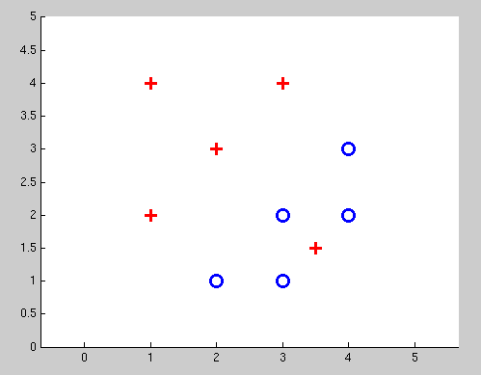
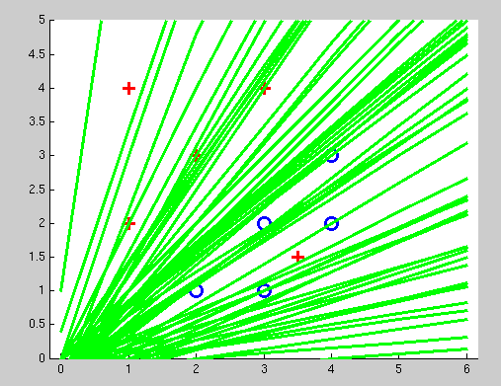
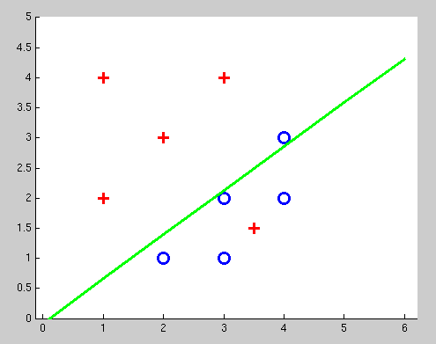
Examples: Perceptron
Non-Separable Case

Slide 11
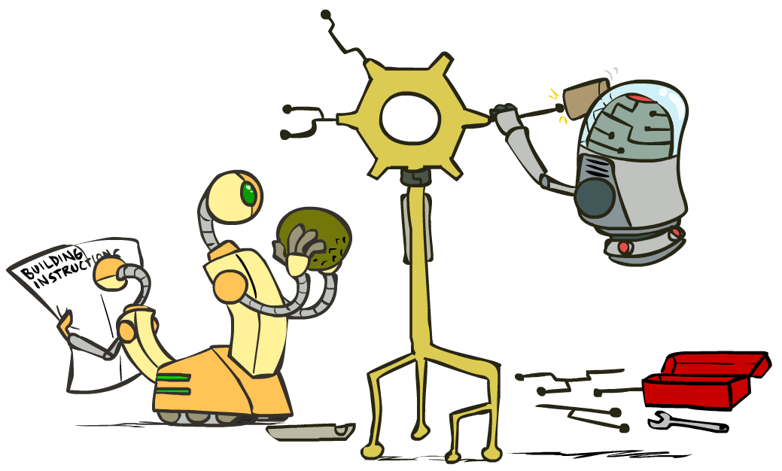
Improving the Perceptron

Slide 12
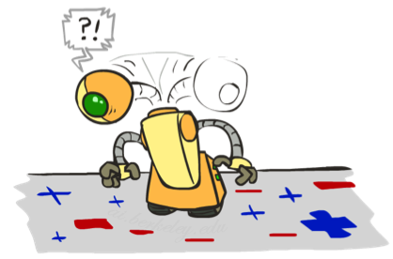
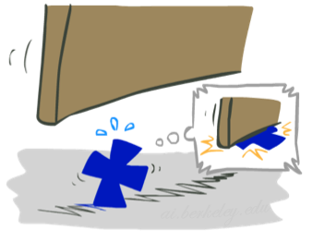

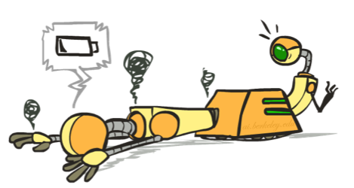




Problems with the Perceptron
Noise: if the data isn’t separable, weights might thrash
Averaging weight vectors over time can help (averaged perceptron)
Mediocre generalization: finds a “barely” separating solution
Overtraining: test / held-out accuracy usually rises, then falls
Overtraining is a kind of overfitting
Notes:
3. Overtraining is easy to fix. Use held-out data to avoid overtraining via “early stopping”.
Next, we will turn to an algorithm that helps the first two problems. It will help us find a better decision boundary, and it will help us avoid thrashing around.

Slide 13
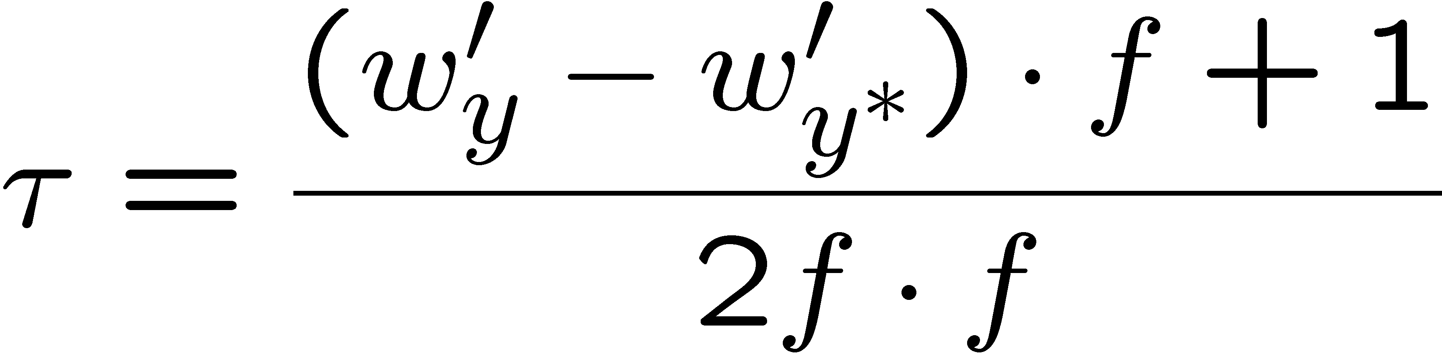
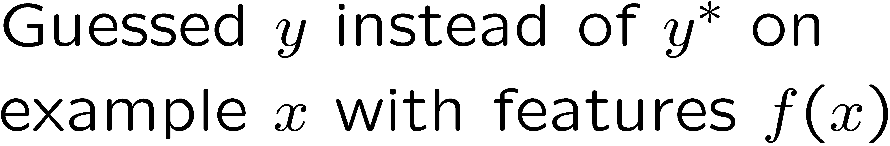
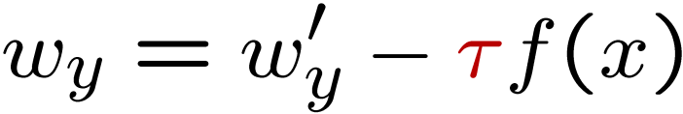
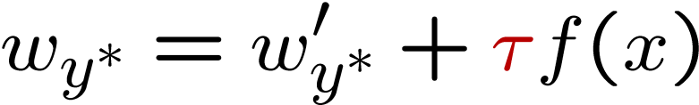
Fixing the Perceptron
Idea: adjust the weight update to mitigate these effects
MIRA = Margin Infused Relaxed Algorithm
Choose an update size that fixes the current mistake…
… but, minimizes the change to w
The +1 helps to generalize
Notes:
MIRA does the following when you make an error:
You re-scale your features by some value Tau. This is like the alpha that we saw in Q-learning. It is a learning rate in some sense. Unlike in Q-learning where this was set heuristically, we are going to have a principled way of setting Tau.
Let’s take a look at it pictorially. We wanted to classify the current thing as y*, but we came up with y as our prediction. What we normally do is subtract out f from wy, and add it to w*, and that would be the perceptron update.
Now we’re going to allow some scaling via tau. Not too much, not too little.
So here’s the equation that we use to choose an update size. We want to pick a new update that has the weight vector for each class (w_y’) to be as close as possible to w_y. You could make that true by just setting w_y’ to be w_y.
But there’s a constraint. We want the w_y to be better for the current item f(x). That’s the second term. And not only do we want it to be better than our previous prediction, and we want it to be correct by a margin of at least +1. This is saying that y* has to be getting a higher score than y +1.
The plus one gives us some margin.
Now we need to solve this. The next slide shows the optimization problem.

Slide 14
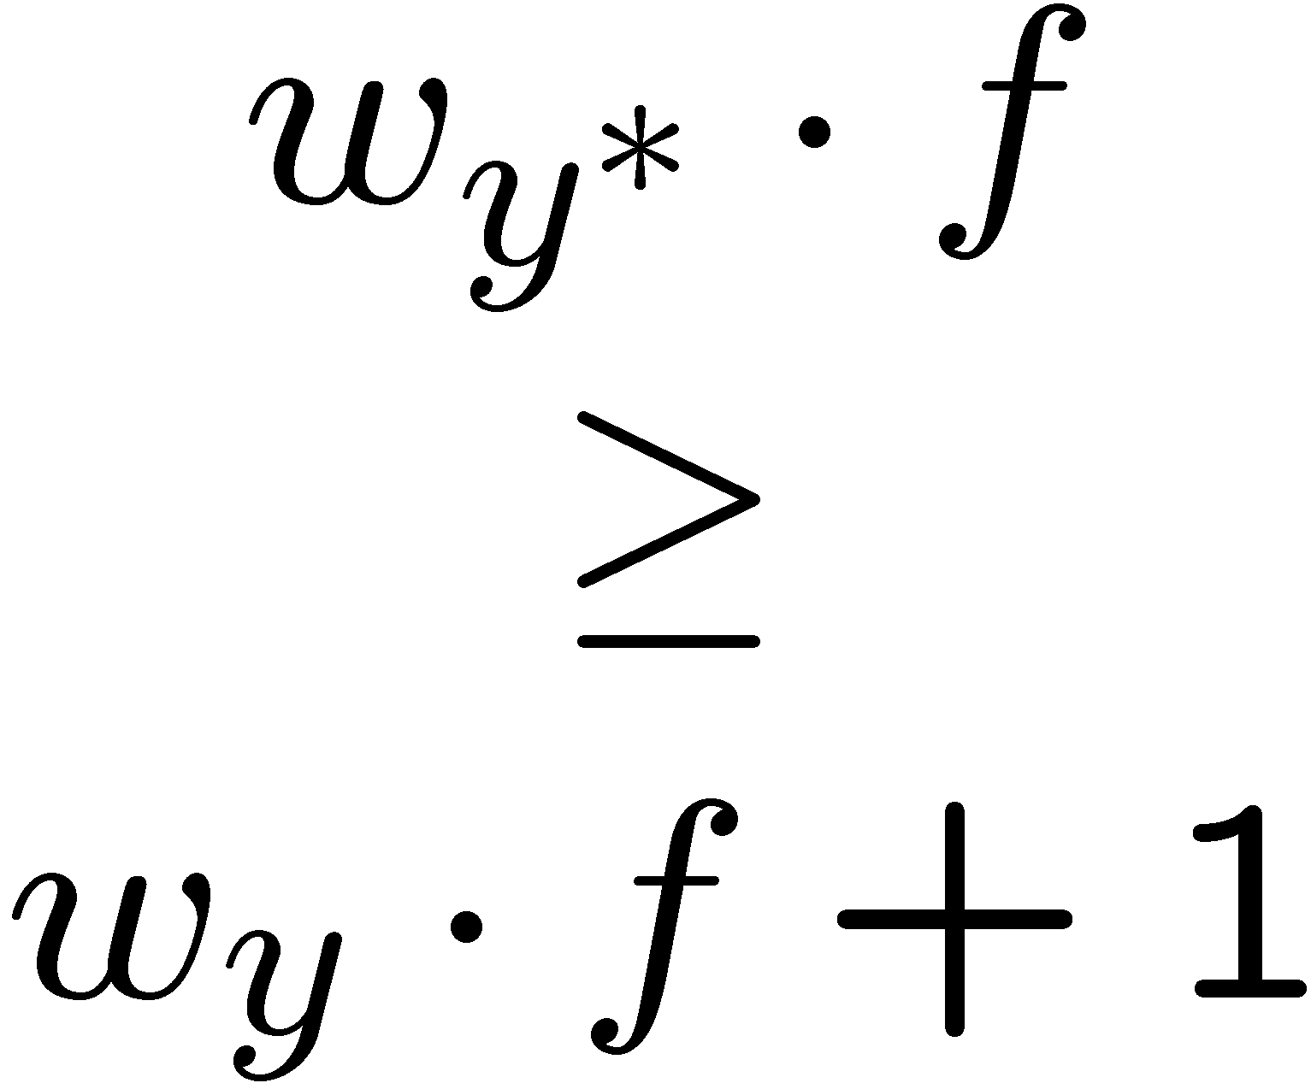
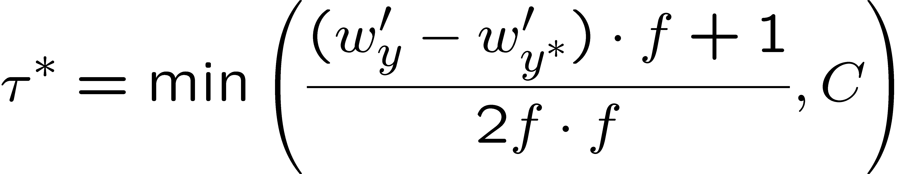

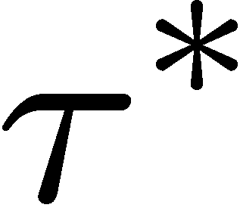

Maximum Step Size
In practice, it’s also bad to make updates that are too large
Example may be labeled incorrectly
You may not have enough features
Solution: cap the maximum possible value of τ with some constant C
Corresponds to an optimization that assumes non-separable data
Usually converges faster than perceptron
Usually better, especially on noisy data

Slide 15
Linear Separators
Which of these linear separators is optimal?

Slide 16
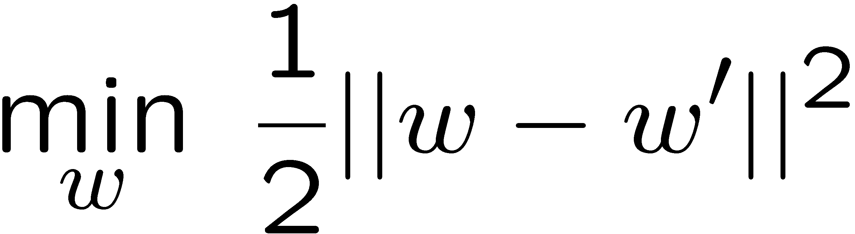
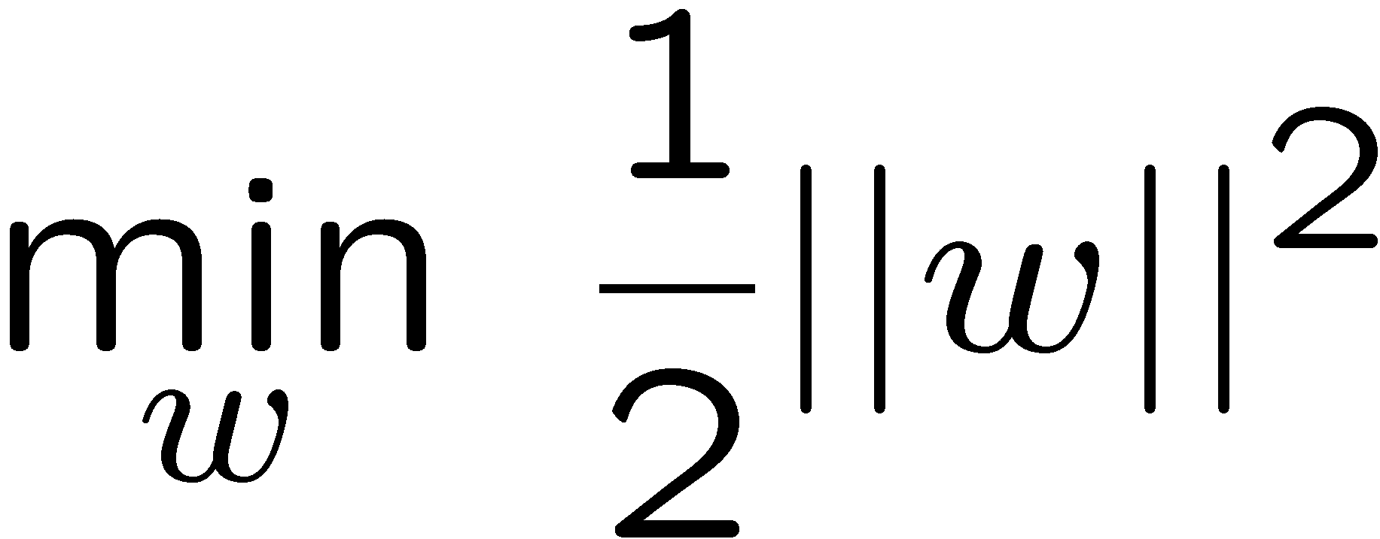
Support Vector Machines
Maximizing the margin: good according to intuition, theory, practice
Only support vectors matter; other training examples are ignorable
Support vector machines (SVMs) find the separator with max margin
Basically, SVMs are MIRA where you optimize over all examples at once
MIRA
SVM

Slide 17
Classification: Comparison
Naïve Bayes
Builds a model training data
Gives prediction probabilities
Strong assumptions about feature independence
One pass through data (counting)
Perceptrons / MIRA:
Makes less assumptions about data
Mistake-driven learning
Multiple passes through data (prediction)
Often more accurate

Slide 18
Kernels and Clustering
AIMA section 18.8
Wikipedia Articles linked from Schedule Page
Slides Courtesy of Dan Klein and Pieter Abbeel --- University of California, Berkeley
[These slides were created by Dan Klein and Pieter Abbeel for CS188 Intro to AI at UC Berkeley. All CS188 materials are available at http://ai.berkeley.edu.]

Slide 19
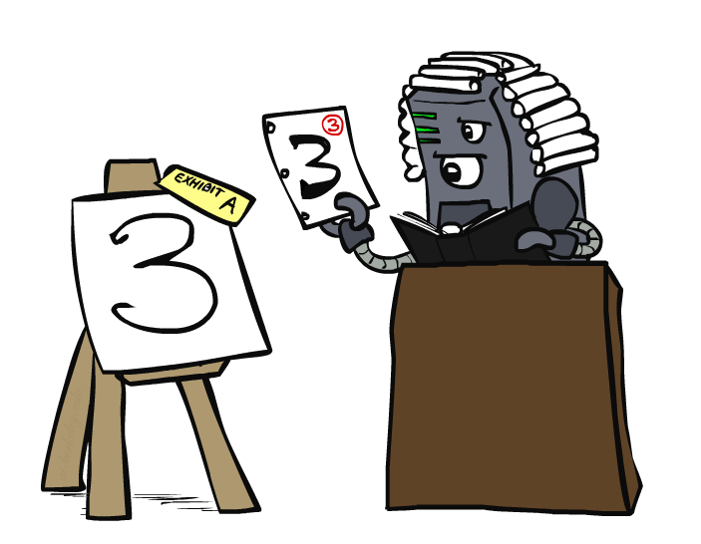
Case-Based Learning

Slide 20
Non-Separable Data

Slide 21
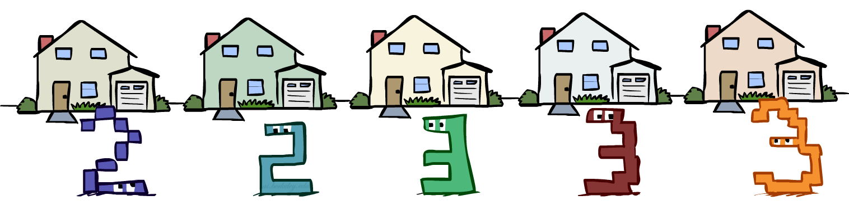
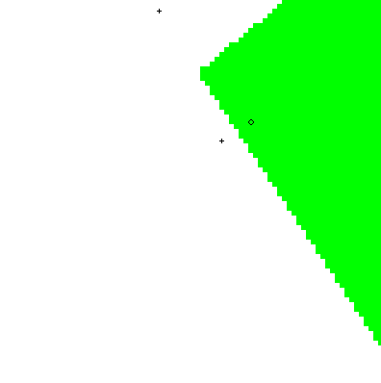
Case-Based Reasoning
Classification from similarity
Case-based reasoning
Predict an instance’s label using similar instances
Nearest-neighbor classification
1-NN: copy the label of the most similar data point
K-NN: vote the k nearest neighbors (need a weighting scheme)
Key issue: how to define similarity
Trade-offs: Small k gives relevant neighbors, Large k gives smoother functions
+
-
+
http://www.cs.cmu.edu/~zhuxj/courseproject/knndemo/KNN.html

Slide 22
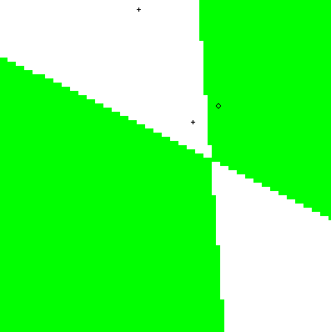

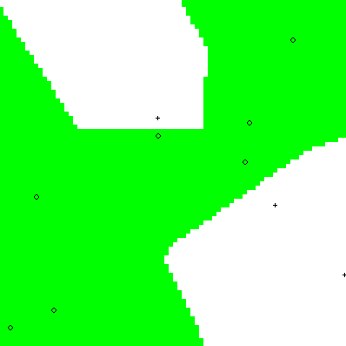
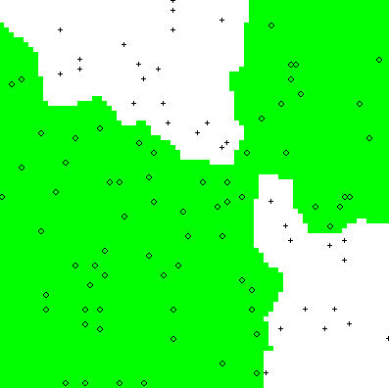
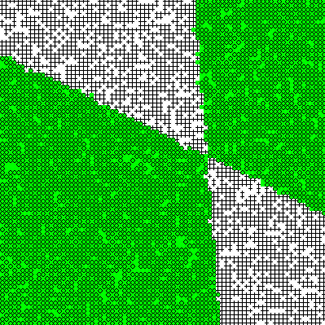
Parametric / Non-Parametric
Parametric models:
Fixed set of parameters
More data means better settings
Non-parametric models:
Complexity of the classifier increases with data
Better in the limit, often worse in the non-limit
(K)NN is non-parametric
Truth
2 Examples
10 Examples
100 Examples
10000 Examples

Slide 23
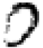




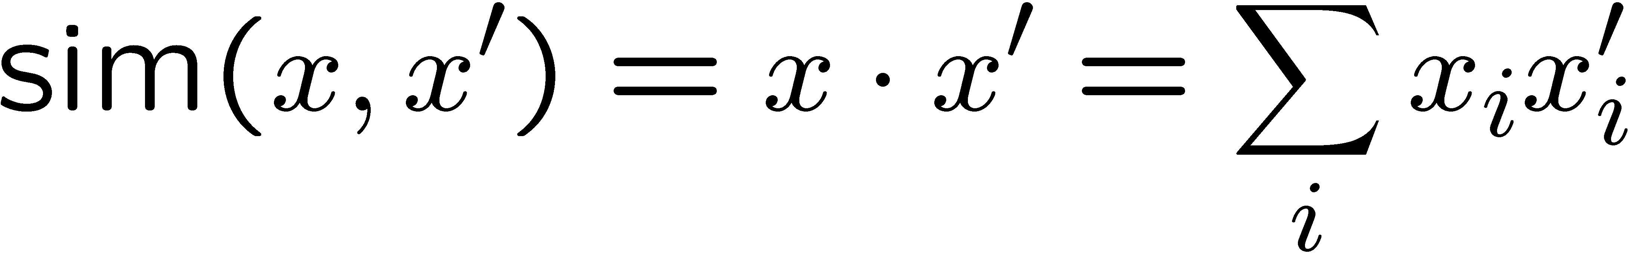

Nearest-Neighbor Classification
Nearest neighbor for digits:
Take new image
Compare to all training images
Assign based on closest example
Encoding: image is vector of intensities:
What’s the similarity function?
Dot product of two images vectors?
Usually normalize vectors so ||x|| = 1
min = 0 (when?), max = 1 (when?)
0
1
2
0
1
2

Slide 24

Similarity Functions

Slide 25

Basic Similarity
Many similarities based on feature dot products:
If features are just the pixels:
Note: not all similarities are of this form

Slide 26


Invariant Metrics
Better similarity functions use knowledge about vision
Example: invariant metrics:
Similarities are invariant under certain transformations
Rotation, scaling, translation, stroke-thickness…
E.g:
16 x 16 = 256 pixels; a point in 256-dim space
These points have small similarity in R²⁵⁶ (why?)
How can we incorporate such invariances into our similarities?
This and next few slides adapted from Xiao Hu, UIUC

Slide 27



Rotation Invariant Metrics
Each example is now a curve in R²⁵⁶
Rotation invariant similarity:
s’=max s( r( ), r( ))
E.g. highest similarity between images’ rotation lines

Slide 28

Tangent Families
Problems with s’:
Hard to compute
Allows large transformations (e.g. 6 → 9)
Tangent distance:
1st order approximation at original points.
Easy to compute
Models small rotations

Slide 29


Template Deformation
Deformable templates:
An “ideal” version of each category
Best-fit to image using min variance
Cost for high distortion of template
Cost for image points being far from distorted template
Used in many commercial digit recognizers
Examples from [Hastie 94]

Slide 30
A Tale of Two Approaches…
Nearest neighbor-like approaches
Can use fancy similarity functions
Don’t actually get to do explicit learning
Perceptron-like approaches
Explicit training to reduce empirical error
Can’t use fancy similarity, only linear
Or can they? Let’s find out!

Slide 31

Kernelization

Slide 32

Perceptron Weights
What is the final value of a weight w_{y} of a perceptron?
Can it be any real vector?
No! It’s built by adding up inputs.
Can reconstruct weight vectors (the primal representation) from update counts (the dual representation)

Slide 33



Dual Perceptron
How to classify a new example x?
If someone tells us the value of K for each pair of examples, never need to build the weight vectors (or the feature vectors)!

Slide 34


Dual Perceptron
Start with zero counts (alpha)
Pick up training instances one by one
Try to classify x_{n},
If correct, no change!
If wrong: lower count of wrong class (for this instance), raise count of right class (for this instance)

Slide 35

Kernelized Perceptron
If we had a black box (kernel) K that told us the dot product of two examples x and x’:
Could work entirely with the dual representation
No need to ever take dot products (“kernel trick”)
Like nearest neighbor – work with black-box similarities
Downside: slow if many examples get nonzero alpha

Slide 36



Kernelized Perceptron Structure

Slide 37
Kernels: Who Cares?
So far: a very strange way of doing a very simple calculation
“Kernel trick”: we can substitute any* similarity function in place of the dot product
Lets us learn new kinds of hypotheses
* Fine print: if your kernel doesn’t satisfy certain technical requirements, lots of proofs break. E.g. convergence, mistake bounds. In practice, illegal kernels sometimes work (but not always).

Slide 38

Non-Linearity

Slide 39
Non-Linear Separators
Data that is linearly separable works out great for linear decision rules:
But what are we going to do if the dataset is just too hard?
How about… mapping data to a higher-dimensional space:
0
x
0
x
x²
0
x
This and next few slides adapted from Ray Mooney, UT

Slide 40
Non-Linear Separators
General idea: the original feature space can always be mapped to some higher-dimensional feature space where the training set is separable:
Φ: x → φ(x)

Slide 41



Some Kernels
Kernels implicitly map original vectors to higher dimensional spaces, take the dot product there, and hand the result back
Linear kernel:
Quadratic kernel:
RBF: infinite dimensional representation
Discrete kernels: e.g. string kernels

Slide 42
Why Kernels?
Can’t you just add these features on your own (e.g. add all pairs of features instead of using the quadratic kernel)?
Yes, in principle, just compute them
No need to modify any algorithms
But, number of features can get large (or infinite)
Some kernels not as usefully thought of in their expanded representation, e.g. RBF kernels
Kernels let us compute with these features implicitly
Example: implicit dot product in quadratic kernel takes much less space and time per dot product
Of course, there’s the cost for using the pure dual algorithms: you need to compute the similarity to every training datum

Slide 43

Recap: Classification
Classification systems:
Supervised learning
Make a prediction given evidence
We’ve seen several methods for this
Useful when you have labeled data

Slide 44

Clustering
Clustering systems:
Unsupervised learning
Detect patterns in unlabeled data
E.g. group emails or search results
E.g. find categories of customers
E.g. detect anomalous program executions
Useful when don’t know what you’re looking for
Requires data, but no labels
Often get gibberish

Slide 45

Clustering

Slide 46

Clustering
Basic idea: group together similar instances
Example: 2D point patterns
What could “similar” mean?
One option: small (squared) Euclidean distance

Slide 47

K-Means

Slide 48

K-Means
An iterative clustering algorithm
Pick K random points as cluster centers (means)
Alternate:
Assign data instances to closest mean
Assign each mean to the average of its assigned points
Stop when no points’ assignments change

Slide 49










K-Means Example

Slide 50


K-Means as Optimization
Consider the total distance to the means:
Each iteration reduces phi
Two stages each iteration:
Update assignments: fix means c, change assignments a
Update means: fix assignments a, change means c
points
means
assignments

Slide 51




Phase I: Update Assignments
For each point, re-assign to closest mean:
Can only decrease total distance phi!

Slide 52


Phase II: Update Means
Move each mean to the average of its assigned points:
Also can only decrease total distance… (Why?)
Fun fact: the point y with minimum squared Euclidean distance to a set of points {x} is their mean

Slide 53

Initialization
K-means is non-deterministic
Requires initial means
It does matter what you pick!
What can go wrong?
Various schemes for preventing this kind of thing: variance-based split / merge, initialization heuristics

Slide 54

K-Means Getting Stuck
A local optimum:
Why doesn’t this work out like the earlier example, with the purple taking over half the blue?

Slide 55

K-Means Questions
Will K-means converge?
To a global optimum?
Will it always find the true patterns in the data?
If the patterns are very very clear?
Will it find something interesting?
Do people ever use it?
How many clusters to pick?

Slide 56

Agglomerative Clustering

Slide 57
Agglomerative Clustering
Agglomerative clustering:
First merge very similar instances
Incrementally build larger clusters out of smaller clusters
Algorithm:
Maintain a set of clusters
Initially, each instance in its own cluster
Repeat:
Pick the two closest clusters
Merge them into a new cluster
Stop when there’s only one cluster left
Produces not one clustering, but a family of clusterings represented by a dendrogram

Slide 58
Agglomerative Clustering
How should we define “closest” for clusters with multiple elements?
Many options
Closest pair (single-link clustering)
Farthest pair (complete-link clustering)
Average of all pairs
Ward’s method (min variance, like k-means)
Different choices create different clustering behaviors

Slide 59

Example: Google News
Top-level categories: supervised classification
Story groupings:
unsupervised clustering

Slide 60
Example: K-Means
[web demo]
http://www.cs.washington.edu/research/imagedatabase/demo/kmcluster/

Slide 61
Next Time: Advanced Applications!

